Slide 1


Ayiti Analytics Bootcamp
Boutique sales products Analysis

Slide 2
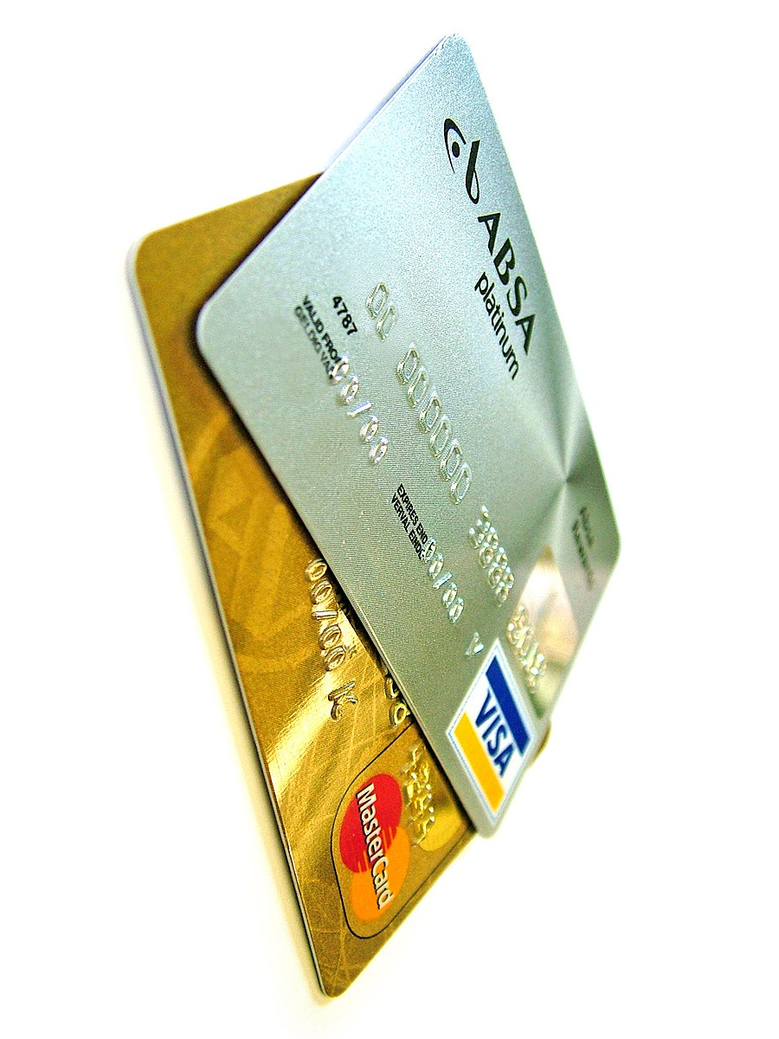
Introduction
The general management of the bank, concerned about the experience of its customers who often complain about the fact that some transactions were made on their credit card without their authorization, and also about the new newspapers that keep saying that the bank does nothing to secure the money of the customers, contacted us to help them solve this problem of fraud that decreases the confidence of customers in their system.

Slide 3

Problem
Defined the problem
The problem is that bank customers complain about fraud on their accounts where they lose large sums of money from their credit cards and despite complaints brought to the media. the bank does nothing to solve its customer problems and this problem also affects both banks and customers.

Slide 4

Stakeholders
Clients
It affects customers because due to the bank’s lack of responsibility they lose large sums of money.
The bank
It affects the bank because their complaints can make them lose to their customers and make them unable to find new customers.
The Media

Slide 5

To realize this work :
we used the data given to us by the bank.
Then we did the processing , analysis and graph of the data using python (pandas, numpy, scipy, seaborn, matplotlib).
We looked at transactions by gender, category and merchant to see if there was one group more likely to be defrauded than another
Result
With all the data we have received after analyze them we will identity the problem and bring some solutions.
Methodology

Slide 6
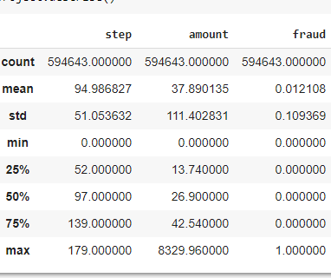
Results
Summary statistic of the data

Slide 7
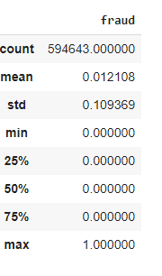
Table of summary statistics on fraud

Slide 8
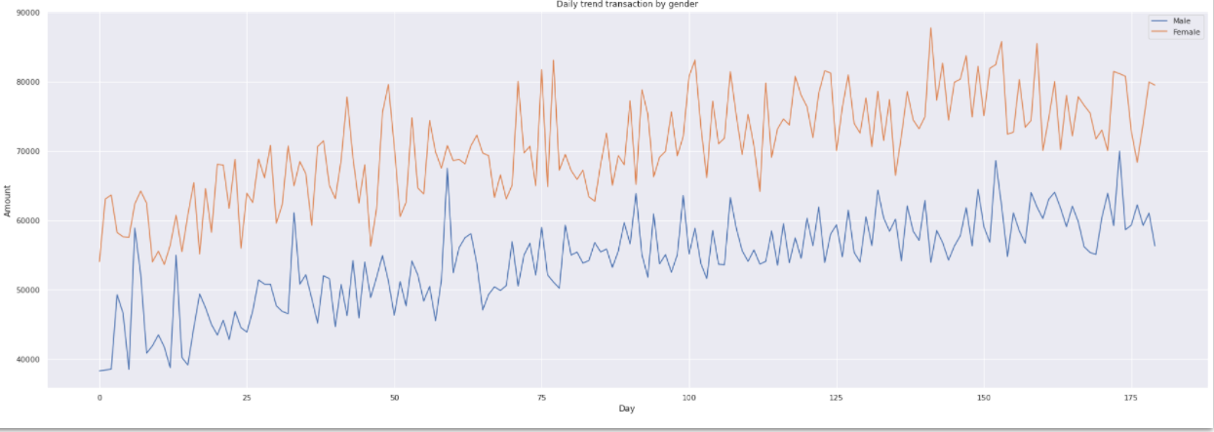
Daily trend transaction by gender
The data show that women tends to purchase more than men. The trend is increasing for the two genders. None of them semms to reduce their purchases for the whole time.

Slide 9
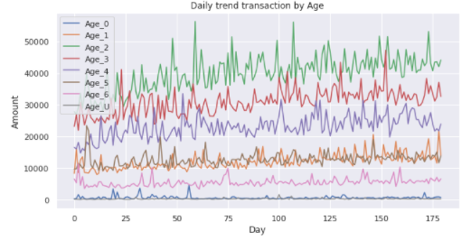
Daily trend by age
This graph shows that the credit cards that have 2 years and 3 years of use are more susceptible to be victim of fraud.

Slide 10
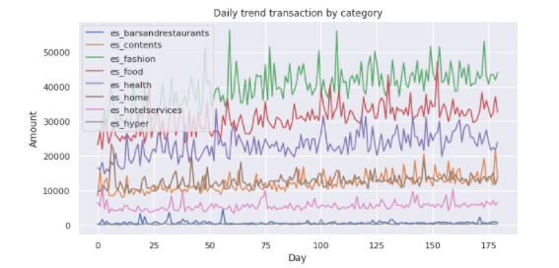
Daily trend transaction by category
As we can see , the daily trend for transport is growing and it is higher than other in amount. Its increasing. That’s mean they are too many transactions in this category.

Slide 11
Daily trend transaction by category
This graph shows that the credit cards that have 2 years and 3 years of use are more susceptible to be victim of fraud.

Slide 12

Proposed Solution
Based on the insights provided by the data processing we did, we can now propose better solution to regain clients trust.
1- Among the transactions of 2000 dollars and more, only one is not a fraud object so they should stop for a while all transactions over 2000 dollars.
2-Implementing a reliable security system and increasing control over credit card transactions

Slide 13

Our thoughts on the fraudulent transactions
I think that the fraudulent transactions depends on variables. The CHI_2 Test shows that clearly. That means there is a specific gender, category, merchant wich are more susceptible to be victim of fraud.
In terms of gender, women are more likely to be victims of fraud. The target age is between 26 and 22 years old and the category concerns transportation

Slide 14
Recommendations
A validation code before each transaction that must be made on the card.
Receiving a message from the bank either by mail or by phone every time the customer is going to make a suspicious transaction
Set up a system to help customers control their accounts and identify merchants with a high percentage of fraud.
Report as fraud all transactions that follow the trend of fraudulent transactions and wait for the customer's opinion before authorizing the transaction.

Slide 15
Other Data and References
Additional data would be required on merchants (gender, age, address) and customers (length of time with the bank)
This additional data will help us to see if fraud is related to the gender of the merchants, and to their geographical location. Does the number of years of experience of customers in the bank
Bank Data
(PDF) BankSim: A Bank Payment Simulation for Fraud Detection Research (researchgate.net)

Slide 16
THANKS
Contact Me
I you have any question about this presentation, Feel free to send us a message in the #business-analysis channel on slack.
Ressources
See the full project

